Slide 1

.
MINI PROJECT
DOMAIN:
MACHINE LEARNING
TITLE:
HANDWRITING RECOGNITION
Guided by
Dr. R. Subhashini,
M.E.,(Ph.D).,
By
Poojasree.S.J [910018104033]
Ramani.N [910018104037]
Vignesh C [910018104047]

Slide 2
.
Project objective:
The handwriting are not always of the same
size , thickness, or orientation and position relative to the margins.
It is a tough task for the machine because handwritten characters are not perfect. The same Characters differ in sizes, shapes and styles from person to person and even from time to time with the same person.
Handwriting Recognition is the solution to this problem that uses the image of a Handwritten Characters and recognizes the Characters present in the image.

Slide 3
.
SVM (Support Vector Machines)
In Machine Learning, Support Vector Machines (SVM) are supervised Learning models with associated learning algorithms that analyze data and recognize patterns, used for classification and regression analysis.
SVM is based on the concepts of decision planes that define decision boundaries.
A decision plane is one that separates between a set of objects having different class memberships.
SVM became famous when, using images as input, it gave accuracy comparable to neural-network with in a handwriting recognition task.
Currently, SVM is widely used in object detection & recognition, content-based image retrieval, text recognition, biometrics, speech recognition etc..
.

Slide 4
LIBRARIES :
Pyscreenshot
Pandas
Scikit-learn
Matplotlib
joblib
Numpy
Opencv-python
Time
cv2
csv
Glob
PLATFORM :
Anaconda Navigator LANGUAGE : Python IDE :
Jupyter Notebook

Slide 5
PROPOSED WORK : STEPS INVOLVED:
Screen capture
Generate dataset and load it
Fit the model using SVC and calculate accurancy
Prediction of image drawn in paint

Slide 6
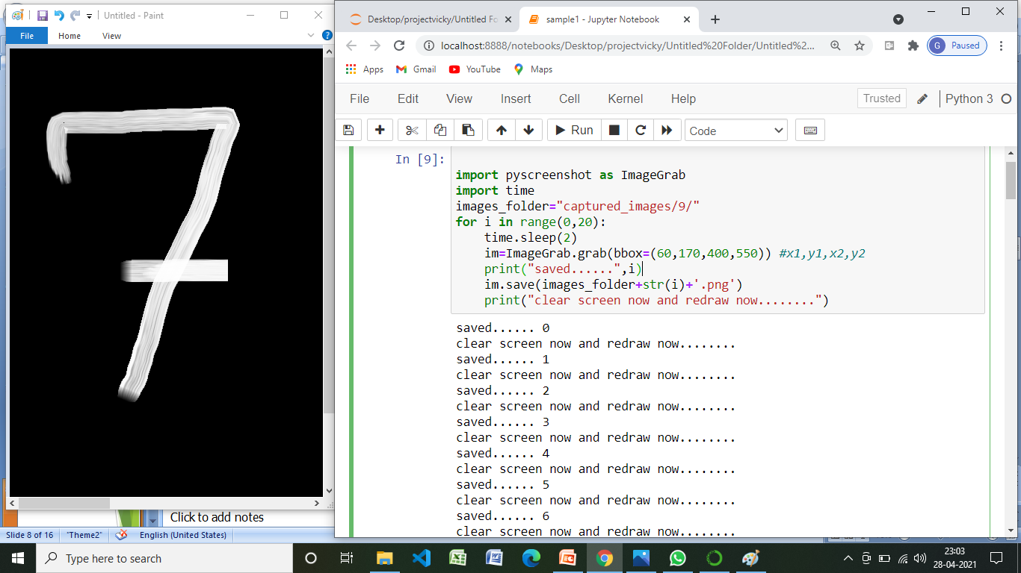
.
Screen capture
.
Using pyscreenshot we created own dataset
im=ImageGrab.grab(bbox=(60,170,400,550)) #x1,y1,x2,y2

Slide 7
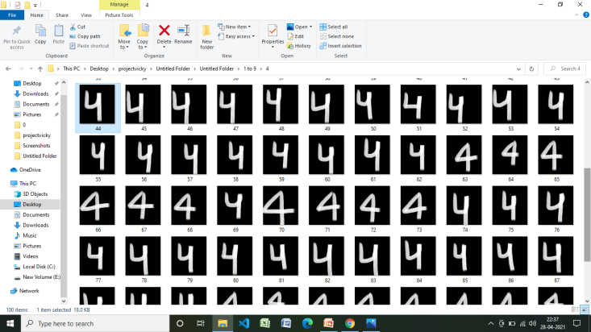
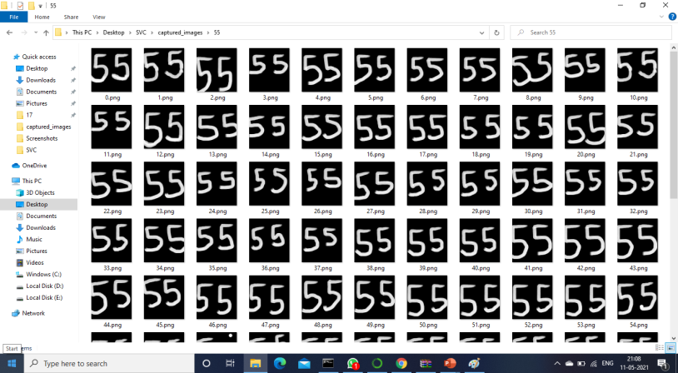
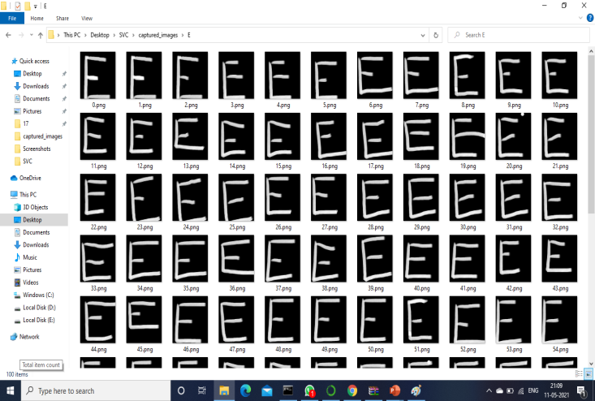
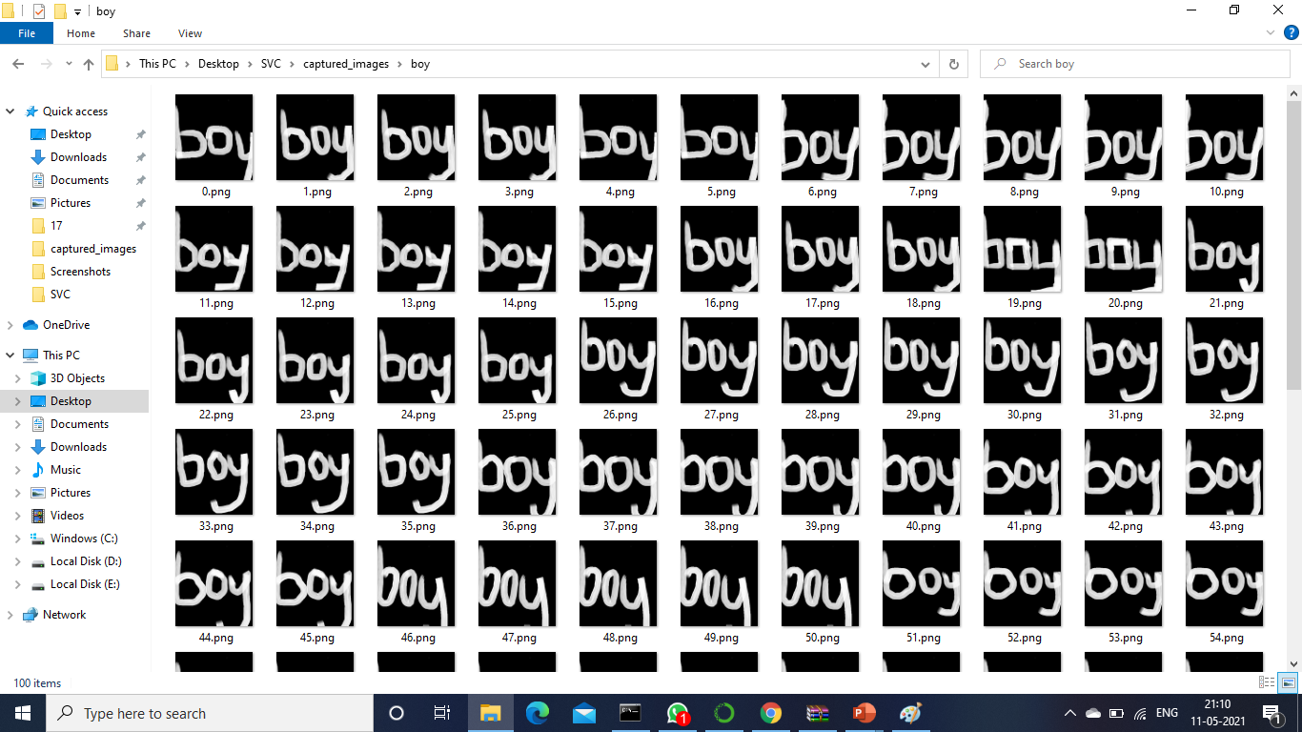
.
In our dataset , first we created 10 folders [0-9] for single digits, and then created 13 folders for double digits, 12 folders for Characters, 6 folders for words, in total we created 41 folders.
Each one has an 100 images and totally there are 4100 images.
For training we used 80% of dataset and for testing we used 20% of dataset

Slide 8
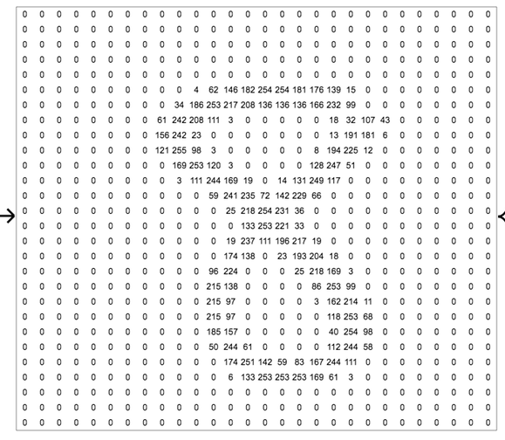
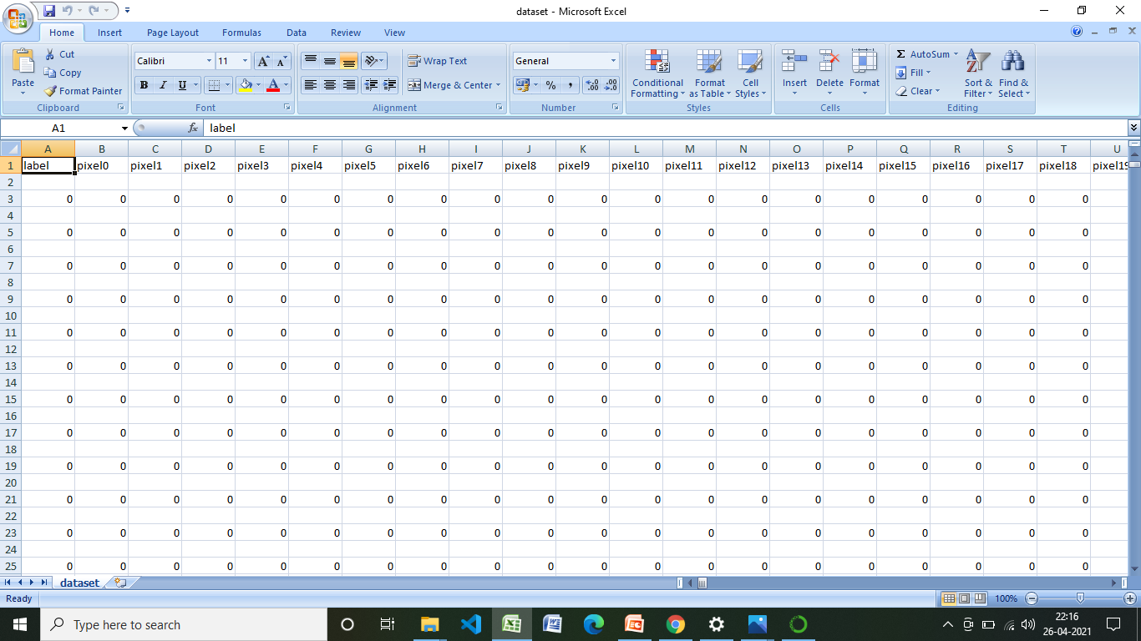
Generate dataset
Appended pixel value from 0 to 783
Extracted image folder
Read all the images using cv2 module
Convert rgb to grayscale image
Using gaussian blur method blur images
Resize the image into 28 *28 pixel
Add pixel one by one into data array
Append the data ie..0 & 1 value from pixel 0 to pixel 783

Slide 9
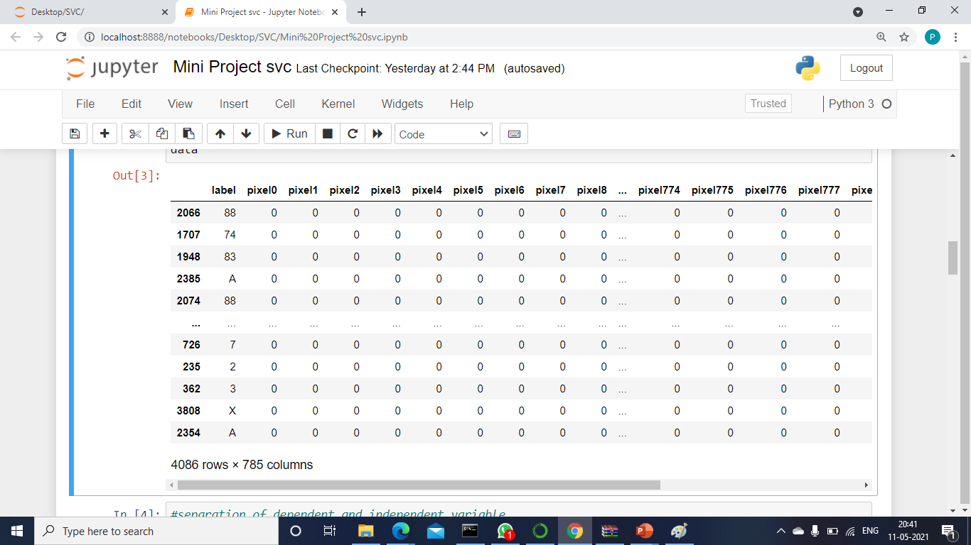
load the dataset
Loaded the data set using pandas library

Slide 10
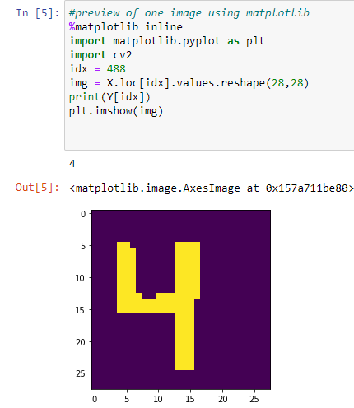
Separation of dependent and independent variable
Training dataset is stored in the form of x train & y train
Testing dataset is stored in the form of x Test & y Test
preview of image using matplotlib
Previewed
one image using index value from the loaded dataset

Slide 11
Train-Test split
80% of dataset for training the model
20 % of dataset for testing the model
Fit the model
Fit the model using svc & save the model using joblib

Slide 12
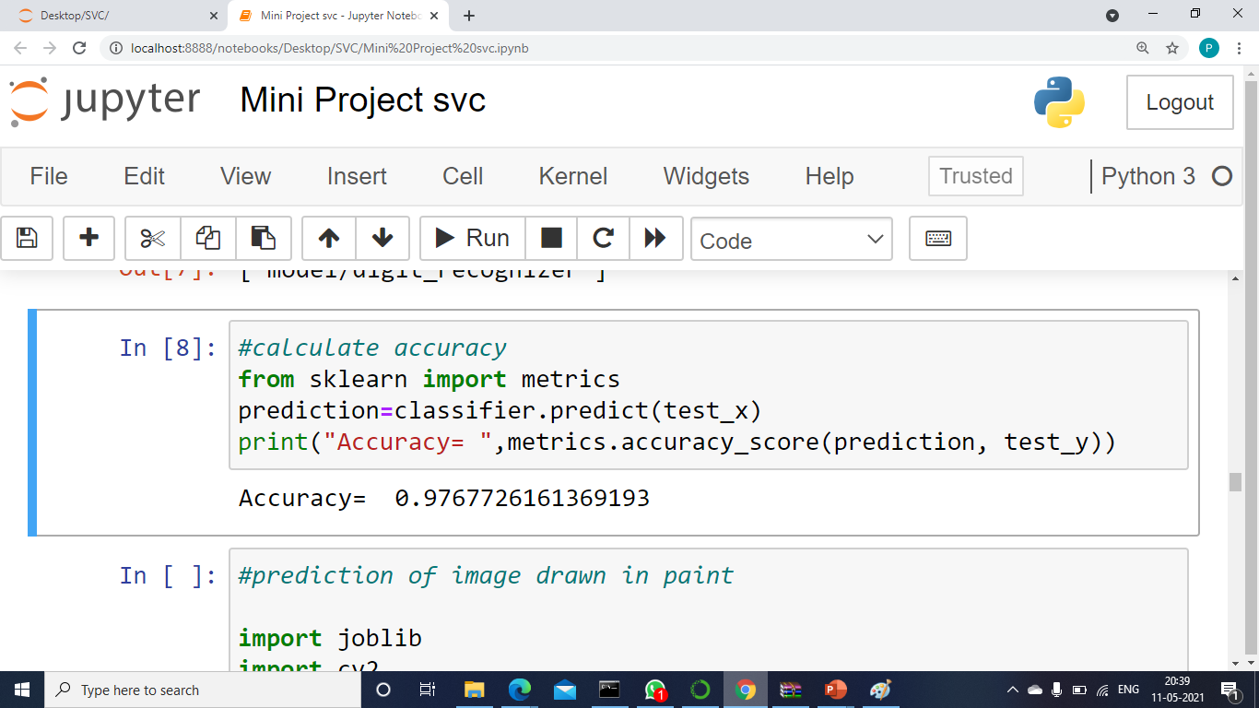
calculate accuracy
Testing dataset x test & y test is used to predict the image & calculate its accuracy

Slide 13
Prediction of image drawn in paint
predicting image using paint & pyscreenshot
And then using time module it will predict after completion of that time
Threshold the image
And then finally it will predict succesfully
Add pixel one by one into data array
.

Slide 14
LITERATURE SURVEY
S.NO | TITLE | AUTHOR(S) | SOURCE (DETAILS OF PUBLICATION) | FINDINGS
1 | Using Random Forests for Handwritten Digit Recognition | S. Bernard S. Adam L. Heutte | IEEE ( Ninth International Conference on Document Analysis and Recognition (ICDAR 2007)) | This aims at studying those methods in a strictly pragmatic approach, in order to provide rules on parameter settings for practitioners. For that purpose we have experimented the forest-RI algorithm, considered as the random forest reference method, on the MNIST handwritten digits database.
2 | On-line handwritten digit recognition based on trajectory and velocity modeling | MonjiKheralla LobnaHaddad Adel M.Alimi AmarMitiche | Elsevier-- The General Direction of Scientific Research and Technological Renovation (DGRSRT), Tunisia, under the ARUB program , 2008 | A system and associated methodology recognizes an Arabic like alphanumeric character using fuzzy modeling. The method receives a handwritten Arabic like alphanumeric character, stores fuzzy models of a plurality of Arabic like alphanumeric characters…

Slide 15
3 | Handwritten Digit Recognition Using Chemical Reaction Optimization | Pritam Khan Boni Bappy Shahriar Abir Md Rafiqul Islam H.M. Mehedi Hasan | IEEE 2018 9th International Conference on Computing, Communication and Networking Technologies (ICCCNT) | This paper propose a new methodology to recognize handwritten Bengali numerals using a recently established metaheuristic algorithm known as Chemical Reaction Optimization (CRO) in order to increase the recognition accuracy. The proposed method produces a higher accuracy rate, 98.96% which is higher than the outcome of any other proposed method.
4 | Effective handwritten digit recognition based on multi-feature extraction and deep analysis | Caiyun Ma Hong Zhang | IEEE 2015 12th International Conference on Fuzzy Systems and Knowledge Discovery (FSKD) | It propose specific feature definitions, including structure features, distribution features and projection features It results on benchmark database of MNIST handwritten digit images show that the performance of our algorithm is remarkable and demonstrate its superiority over several existing algorithms.

Slide 16
REFERENCES
Y. LeCun et al., "Backpropagation applied to handwritten zip code recognition," Neural computation, vol. 1, no. 4, pp. 541- 551, 1989.
A. Krizhevsky, I. Sutskever, and G. E. Hinton, "Imagenet classification with deep convolutional neural networks," in Advances in neural information processing systems, 2012, pp. 1097-1105.
D. Hubel and T. Wiesel, "Aberrant visual projections in the Siamese cat," The Journal of physiology, vol. 218, no. 1, pp. 33- 62, 1971.
Y. LeCun, Y. Bengio, and G. Hinton, "Deep learning," nature, vol. 521, no. 7553, p. 436, 2015.
D. Cireşan, U. Meier, and J. Schmidhuber, "Multi-column deep neural networks for image classification," arXiv preprint arXiv:1202.2745, 2012.
K. Fukushima and S. Miyake, "Neocognitron: A self-organizing neural network model for a mechanism of visual pattern recognition," in Competition and cooperation in neural nets: Springer, 1982, pp. 267-285.

Slide 17
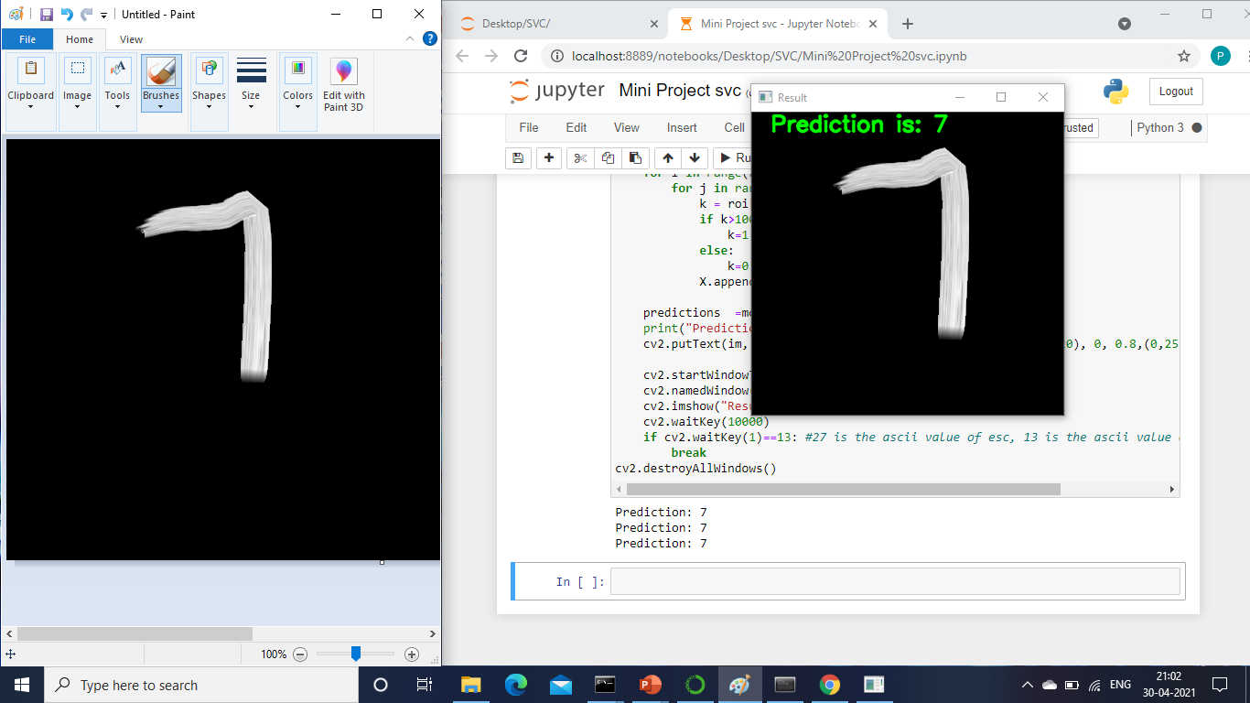
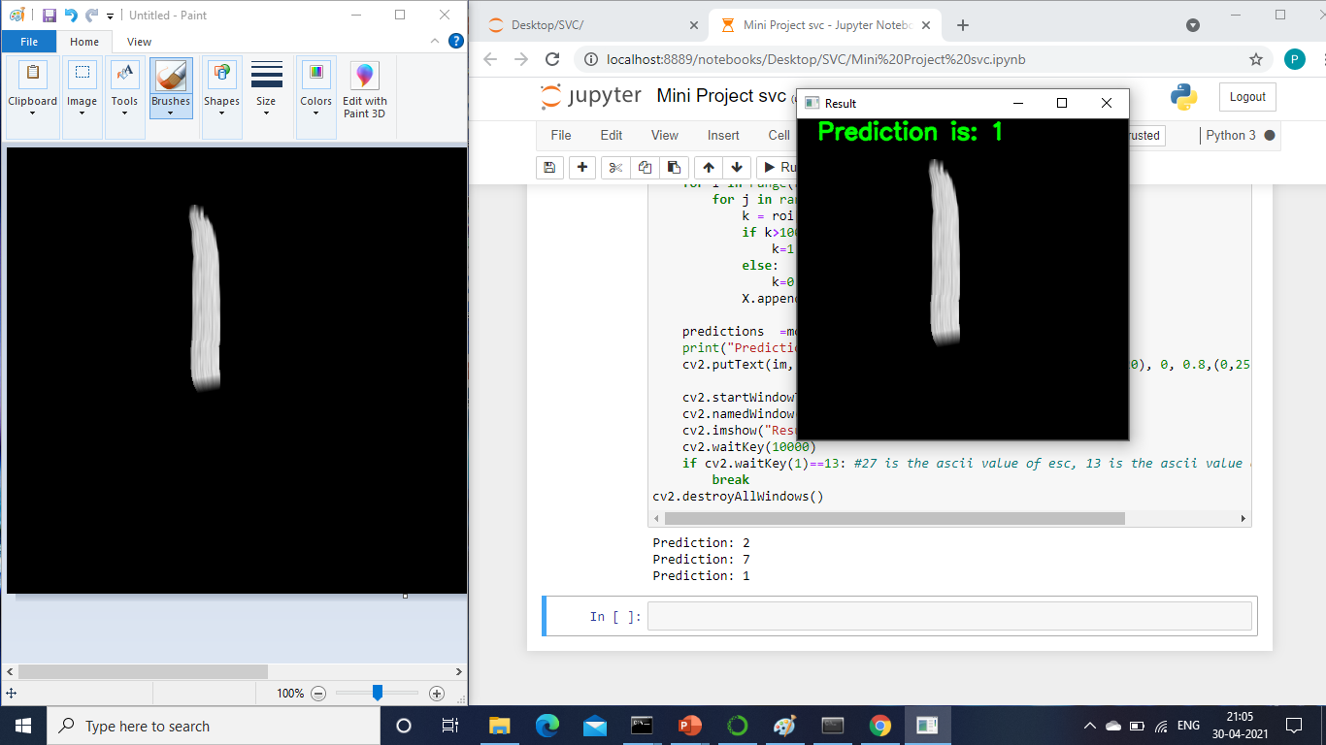
RESULTS AND OUTPUTS :
FOR SINGLE DIGITS

Slide 18
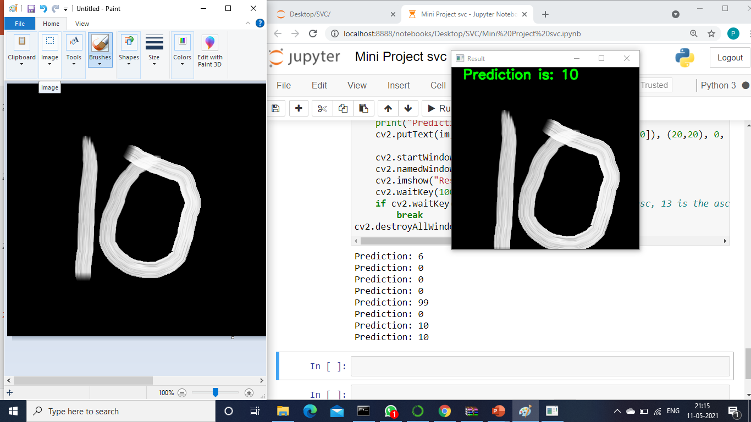
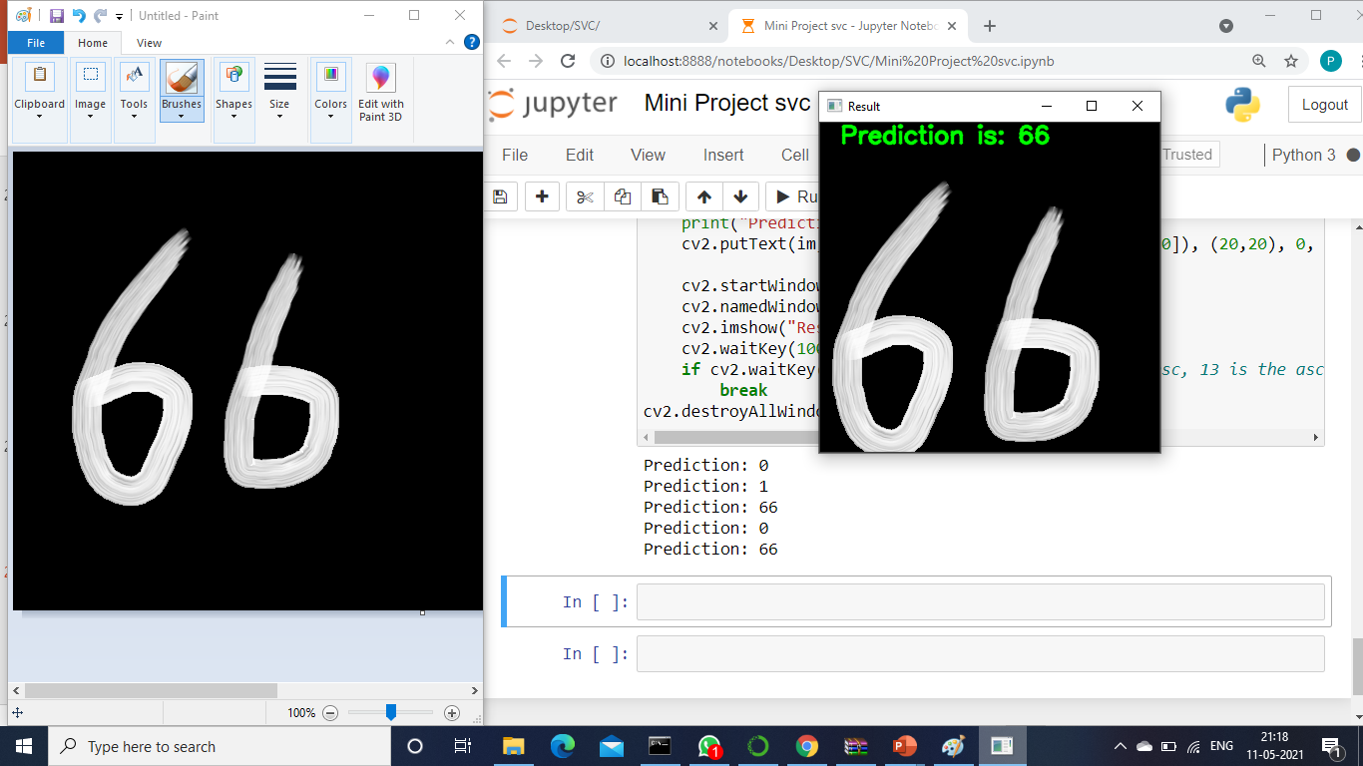
FOR DOUBLE DIGITS :

Slide 19
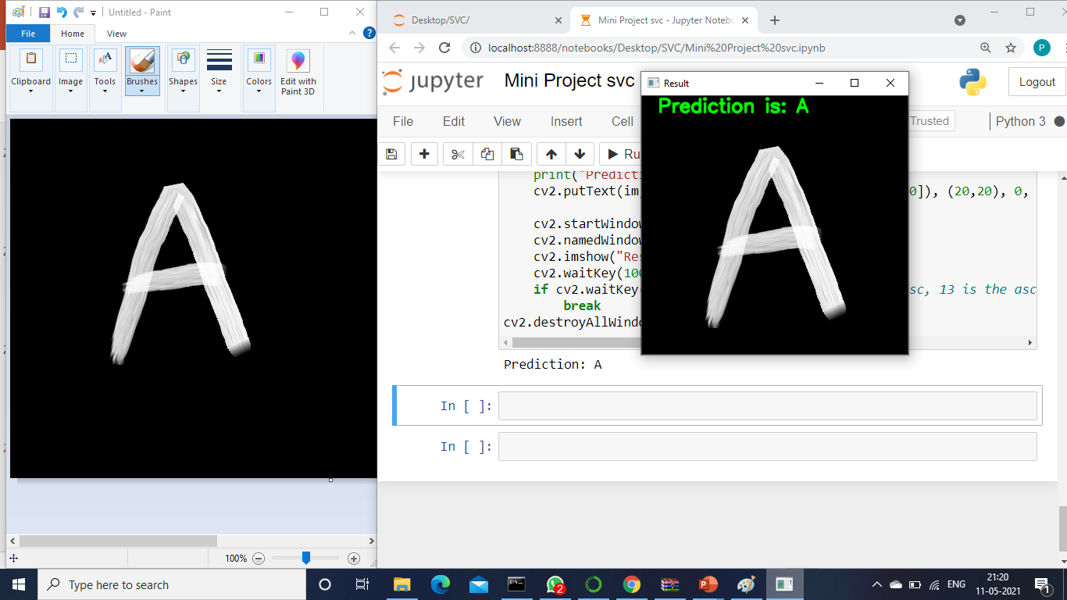
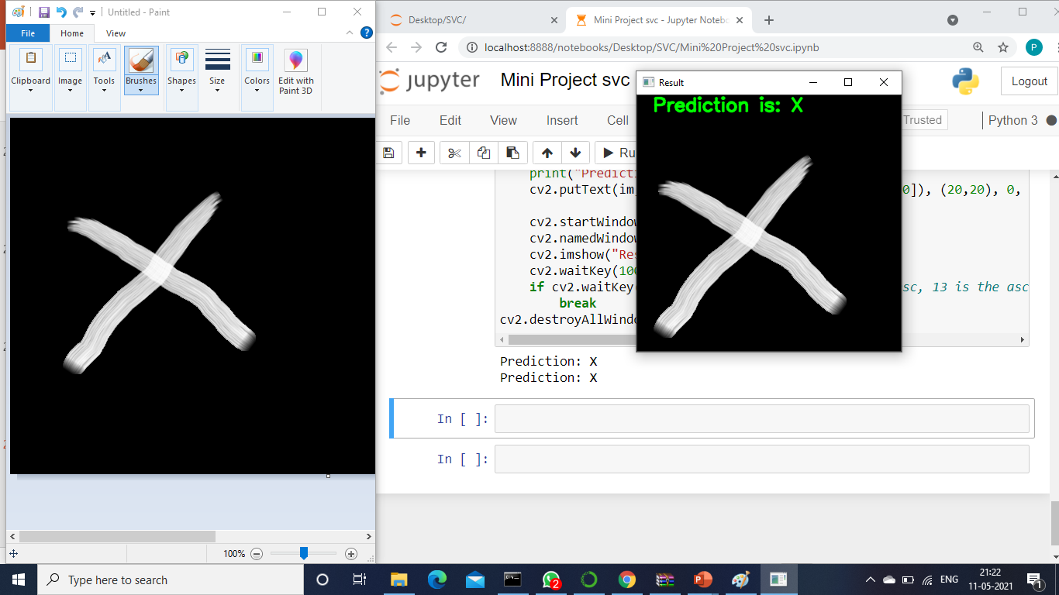
FOR CHARACTERS :
.

Slide 20
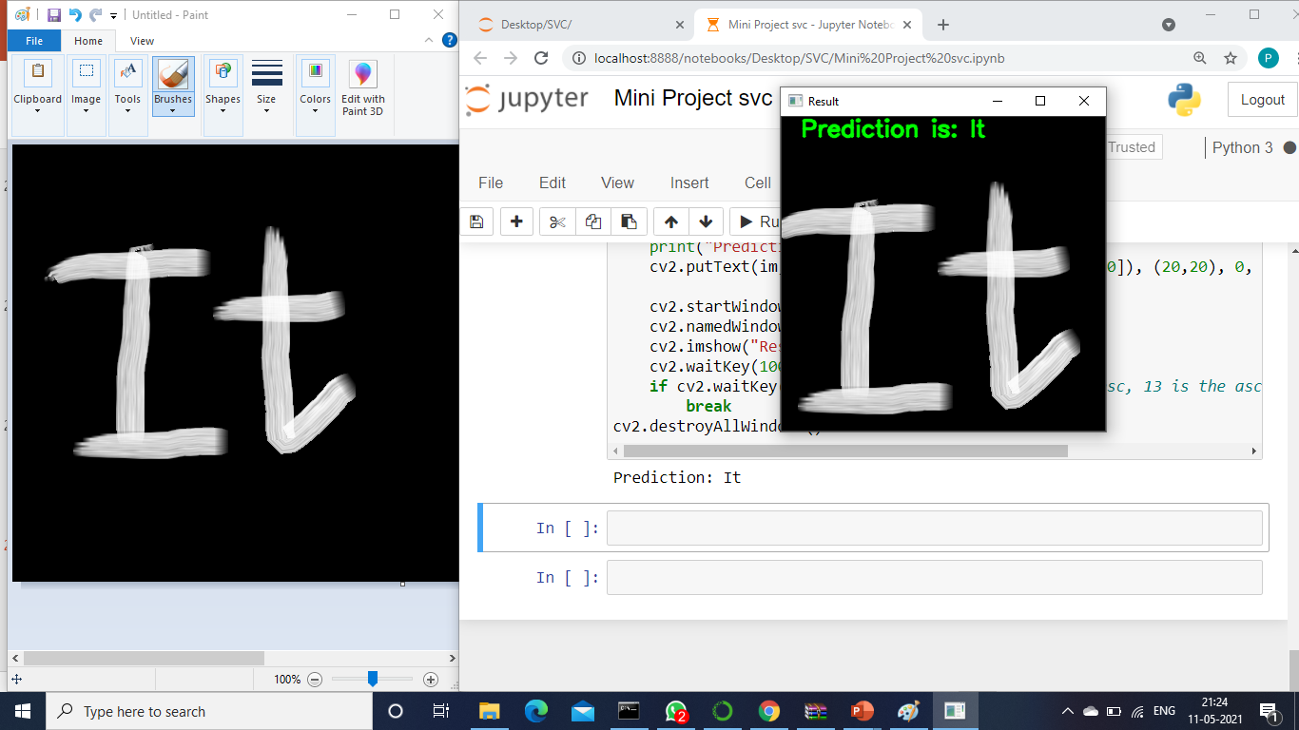
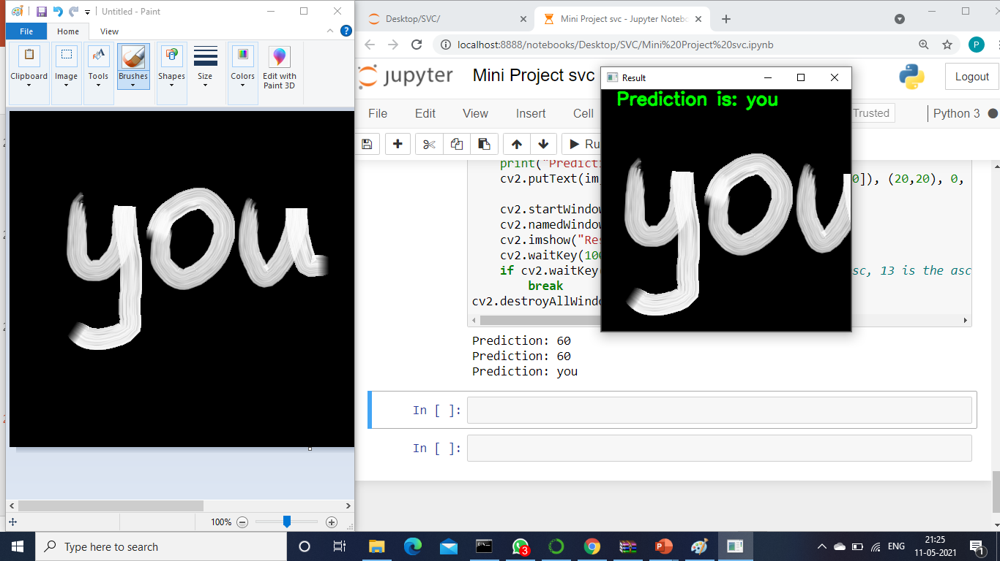
FOR WORDS :

Slide 21
THANK YOU

